Slide 1
Methods of Threads
IN Java

Slide 2
Java Thread suspend() method
The suspend() method of thread class puts the thread from running to waiting state. This method is used if you want to stop the thread execution and start it again when a certain event occurs. This method allows a thread to temporarily cease execution. The suspended thread can be resumed using the resume() method.
Syntax
public final void suspend()
Return
This method does not return any value.
Exception
Security Exception: If the current thread cannot modify the thread.

Slide 3
Java Thread resume() method
The resume() method of thread class is only used with suspend() method. This method is used to resume a thread which was suspended using suspend() method. This method allows the suspended thread to start again.
Syntax
public final void resume()
Return value
This method does not return any value.
Exception
Security Exception: If the current thread cannot modify the thread.

Slide 4
Java Thread stop() method
The stop() method of thread class terminates the thread execution. Once a thread is stopped, it cannot be restarted by start() method.
Syntax
public final void stop()
public final void stop(Throwable obj)
Parameter
obj : The Throwable object to be thrown.
Return
This method does not return any value.
Exception
SecurityException: This exception throws if the current thread cannot modify the thread.

Slide 5
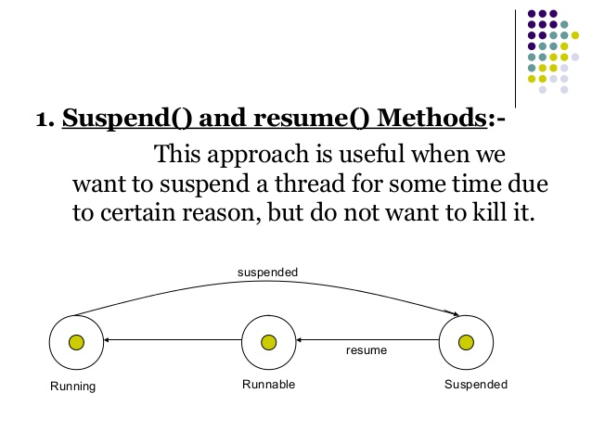

Slide 6
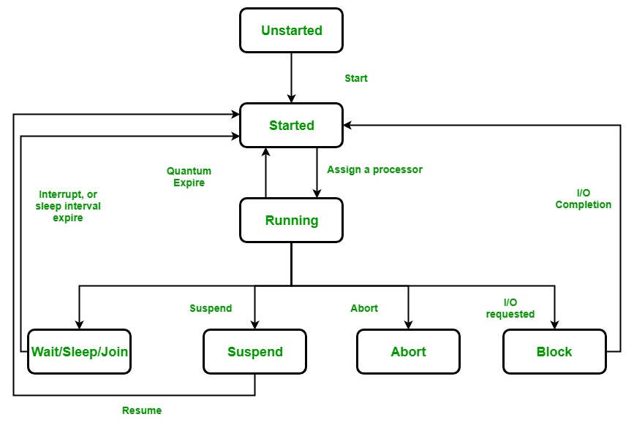
Lifecycle and States of a Thread

